Slide 1
Association Analysis on Demographic Data and Liked Content
Péter Ivanics
Wednesday 1. November 2017
Peter.ivanics@helsinki.fi

Slide 2

What is Choicely?
Comprehensive voting/audience engagement platform
Voting tools for visual polls, questions, surveys, sweepstakes
Typical use cases:
TV and radio shows
beauty pageants,
sports events
talent shows
design contests

Slide 4

Data
Users
Contest organizers
Demographic data
Contestants (images)
Vote data
Contests

Slide 5
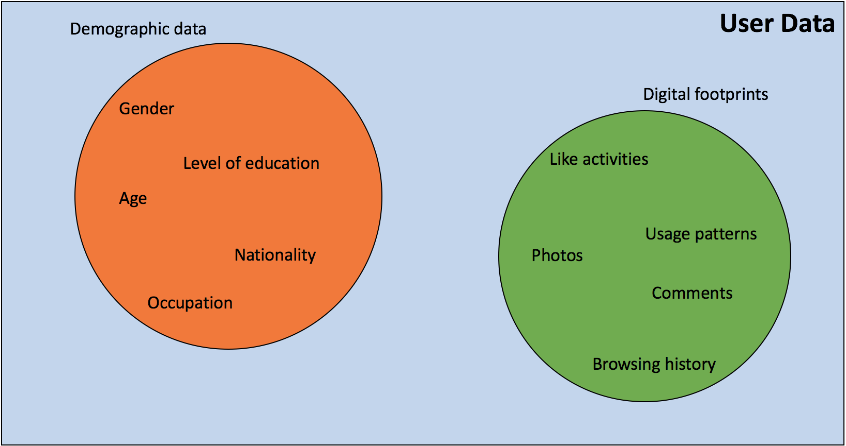

Slide 6
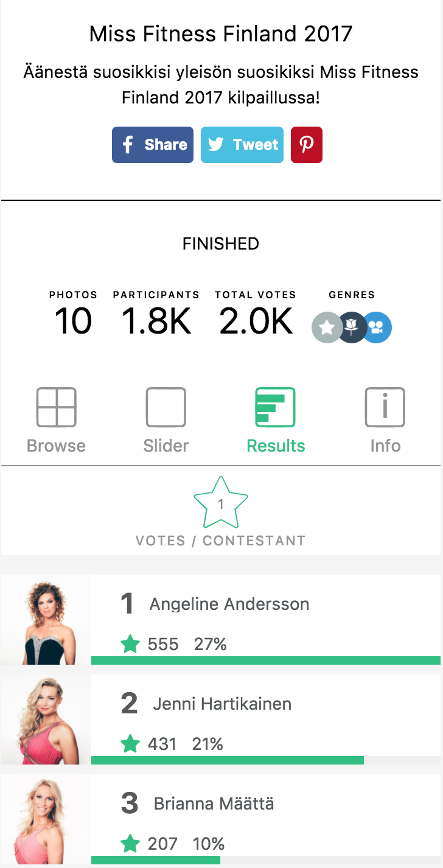
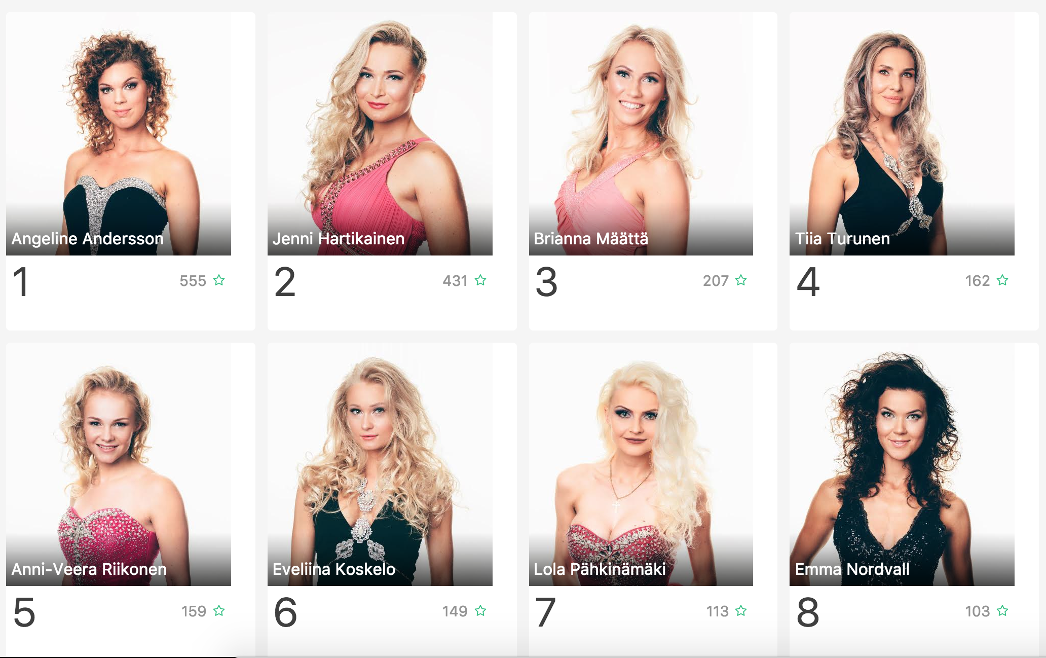

Slide 7
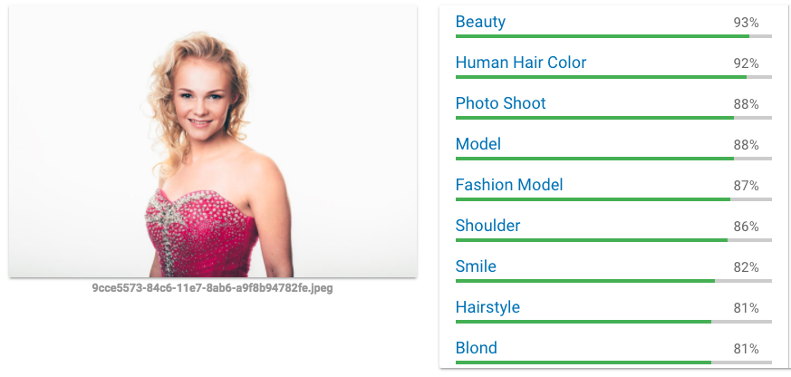
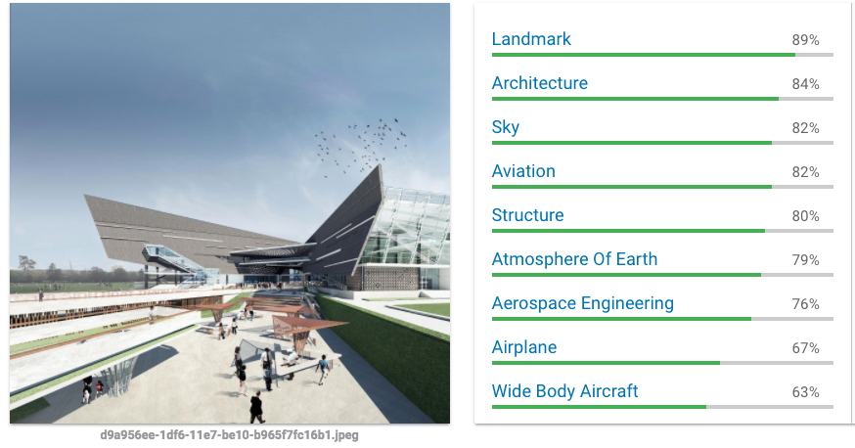
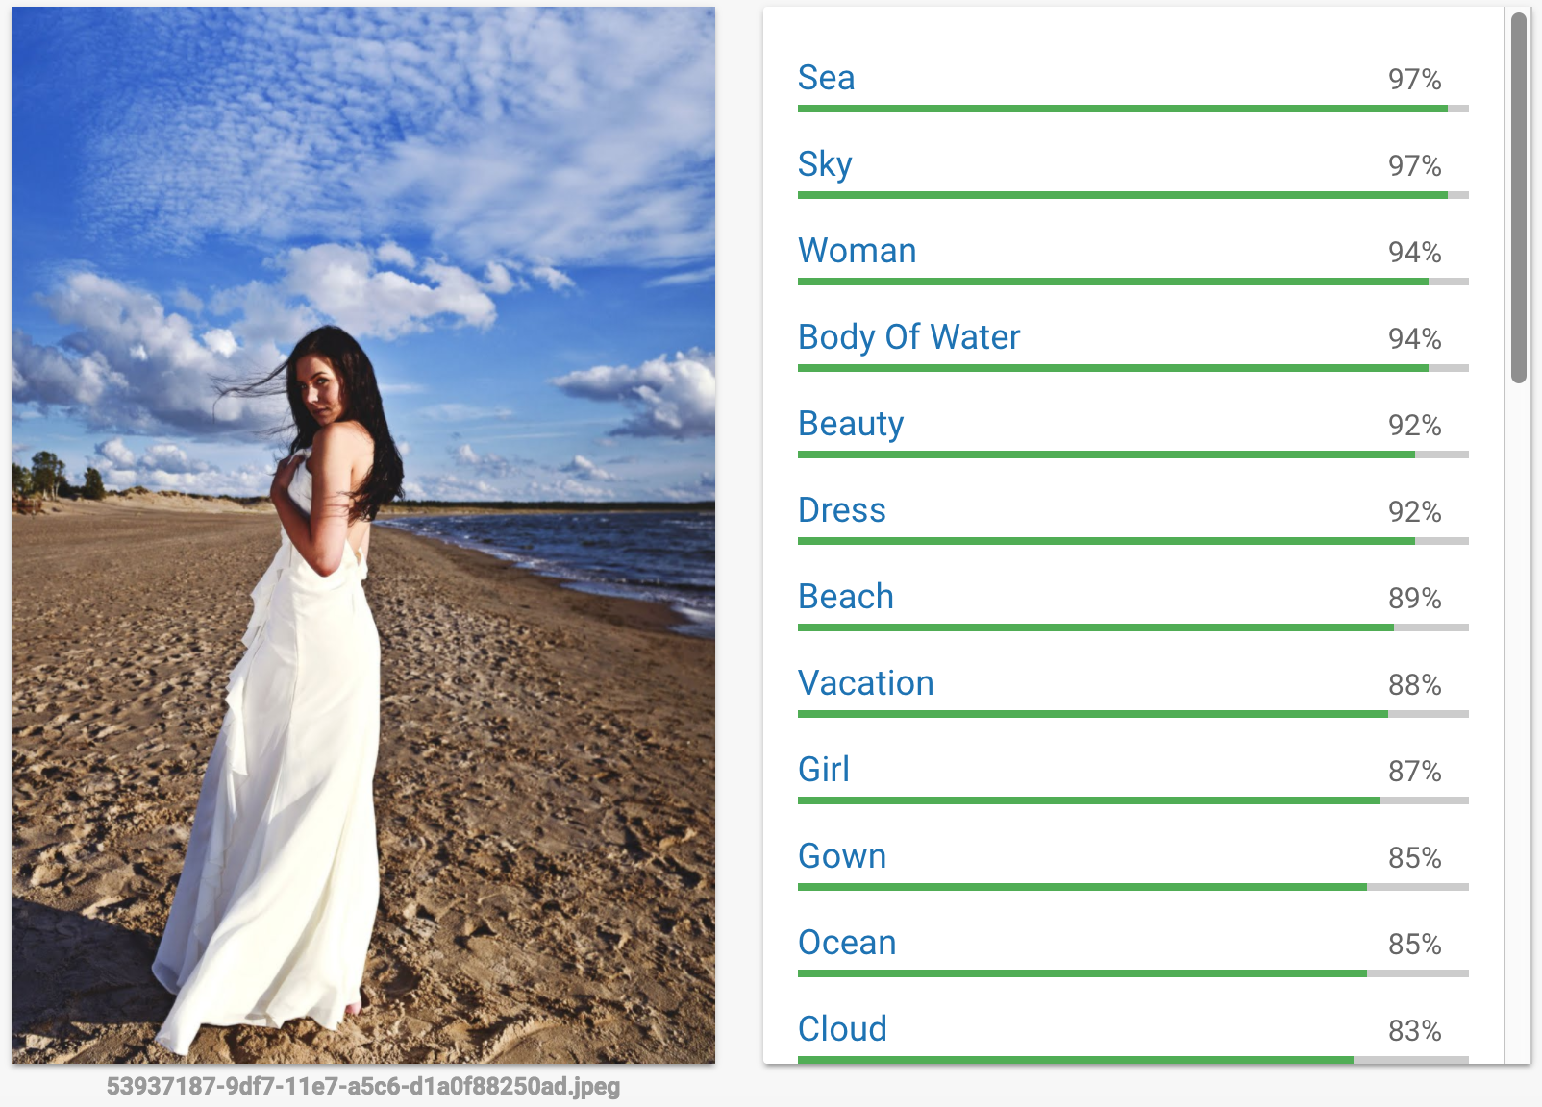
https://cloud.google.com/vision/

Slide 8
Data structure
Google Datastore
Data analysis
Google BigQuery
Local Cache
f
Google Vision
Google Cloud
Functions

Slide 9
Wrangling
contest_id | gender | age_group | country | image_id | tags
5750085036015610 | female | 25-34 | fin | 9d33085c-84c6-11e7-8abb-a9f8b94782fe | ['fashion model', 'hair', 'model', 'beauty', 'human hair color', 'supermodel', 'blond', 'photo shoot', 'shoulder']
5750085036015610 | female | 18-24 | fin | 9d33085c-84c6-11e7-8abb-a9f8b94782fe | ['fashion model', 'hair', 'model', 'beauty', 'human hair color', 'supermodel', 'blond', 'photo shoot', 'shoulder']
5750085036015610 | female | 65+ | fin | 9d33085c-84c6-11e7-8abb-a9f8b94782fe | ['fashion model', 'hair', 'model', 'beauty', 'human hair color', 'supermodel', 'blond', 'photo shoot', 'shoulder']
5750085036015610 | female | 18-24 | swe | 9d33085c-84c6-11e7-8abb-a9f8b94782fe | ['fashion model', 'hair', 'model', 'beauty', 'human hair color', 'supermodel', 'blond', 'photo shoot', 'shoulder']
5750085036015610 | female | 18-24 | swe | 9d134a94-84c6-11e7-a91f-a9f8b94782fe | ['beauty', 'blond', 'human hair color', 'model', 'supermodel', 'fashion model', 'photo shoot', 'shoulder']

Slide 10
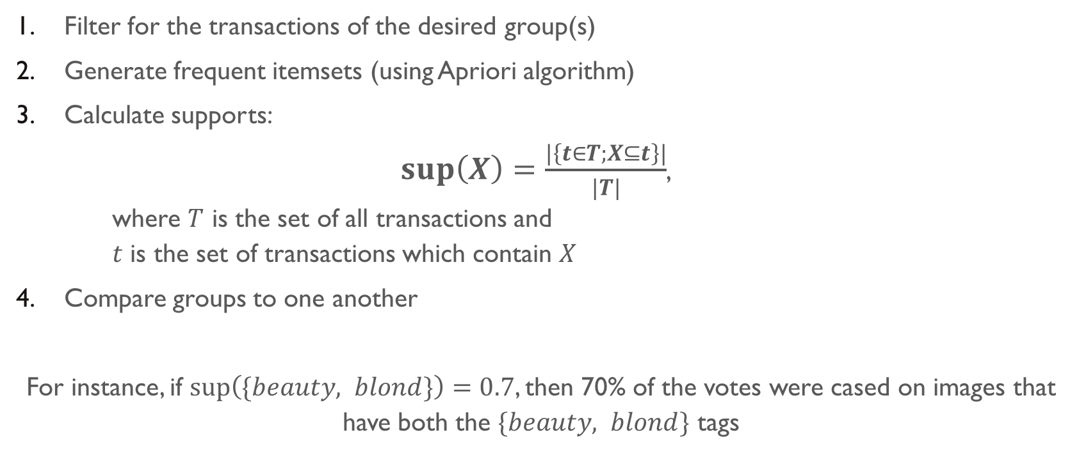
Frequent itemset analysis
Filter for the transactions of the desired group(s)
Generate frequent itemsets (using Apriori algorithm)
Calculate supports: $sup\left(X\right)=\frac{|\left\{t∈T;X⊆t\right\}|}{|T|}$, where $T$ is the set of all transactions and $t$ is the set of transactions which contain $X$
Compare groups to one another
For instance, if $sup\left(\{beauty, blond\}\right)=0.7$, then 70% of the votes were cased on images that have both the $\{beauty, blond\}$ tags

Slide 11
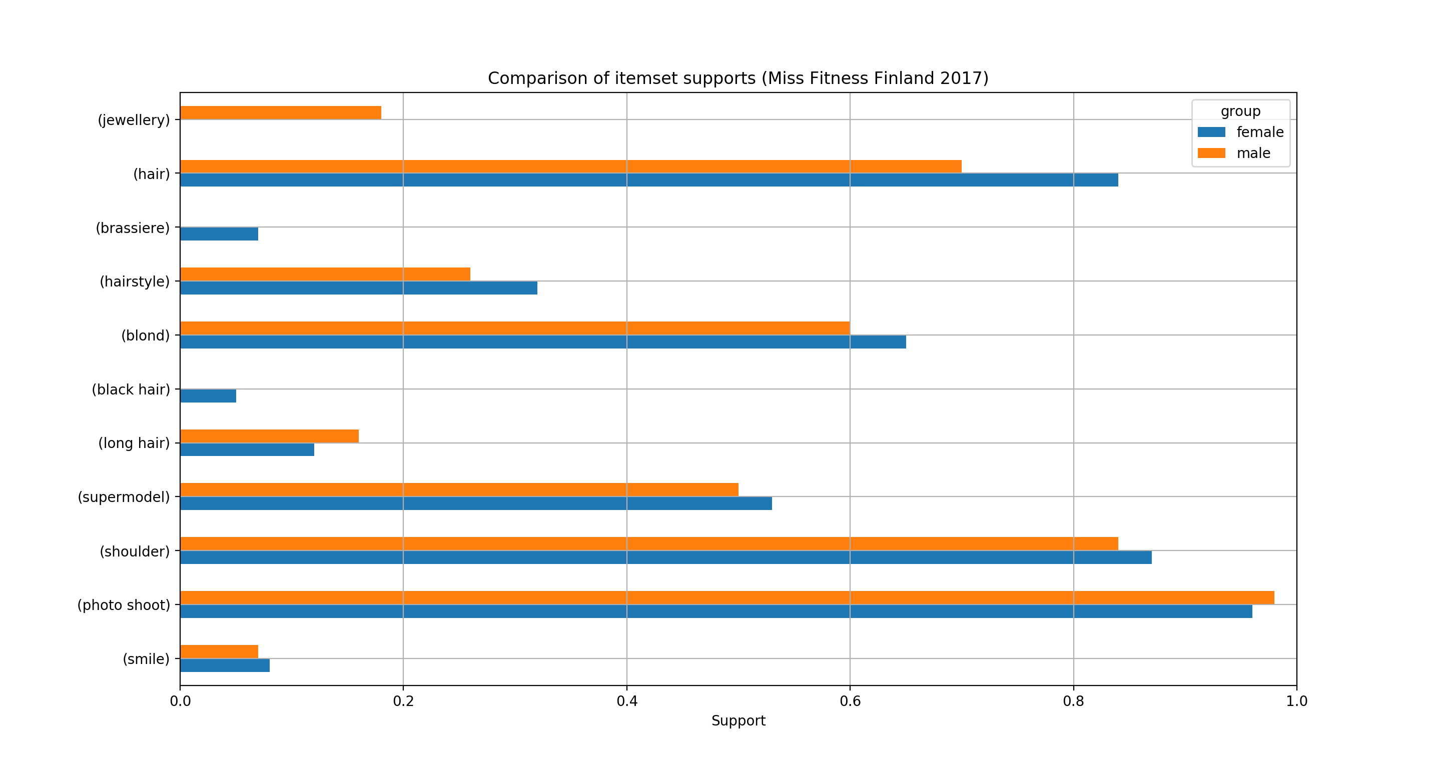
https://choicely.com/contest/7a7b90f8-84c7-11e7-a452-a9f8b94782fe/

Slide 12
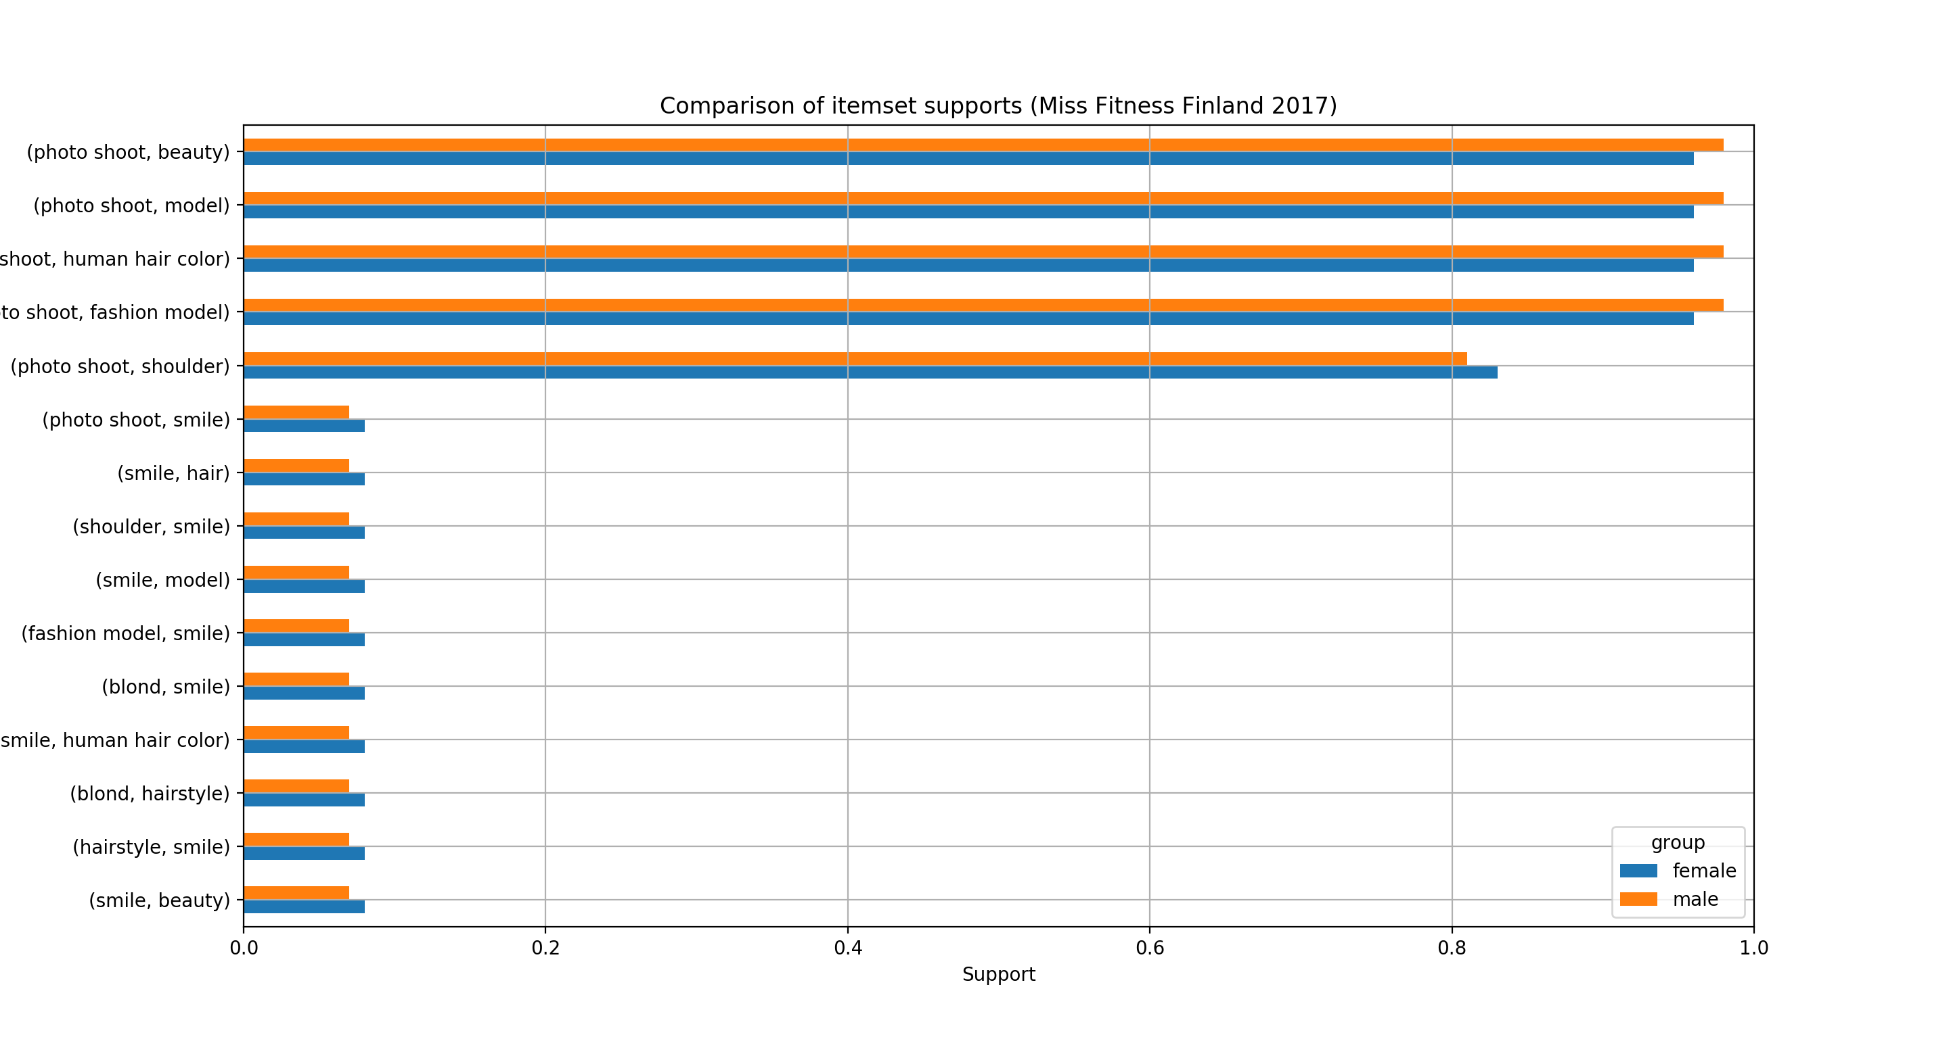
https://choicely.com/contest/7a7b90f8-84c7-11e7-a452-a9f8b94782fe/

Slide 13
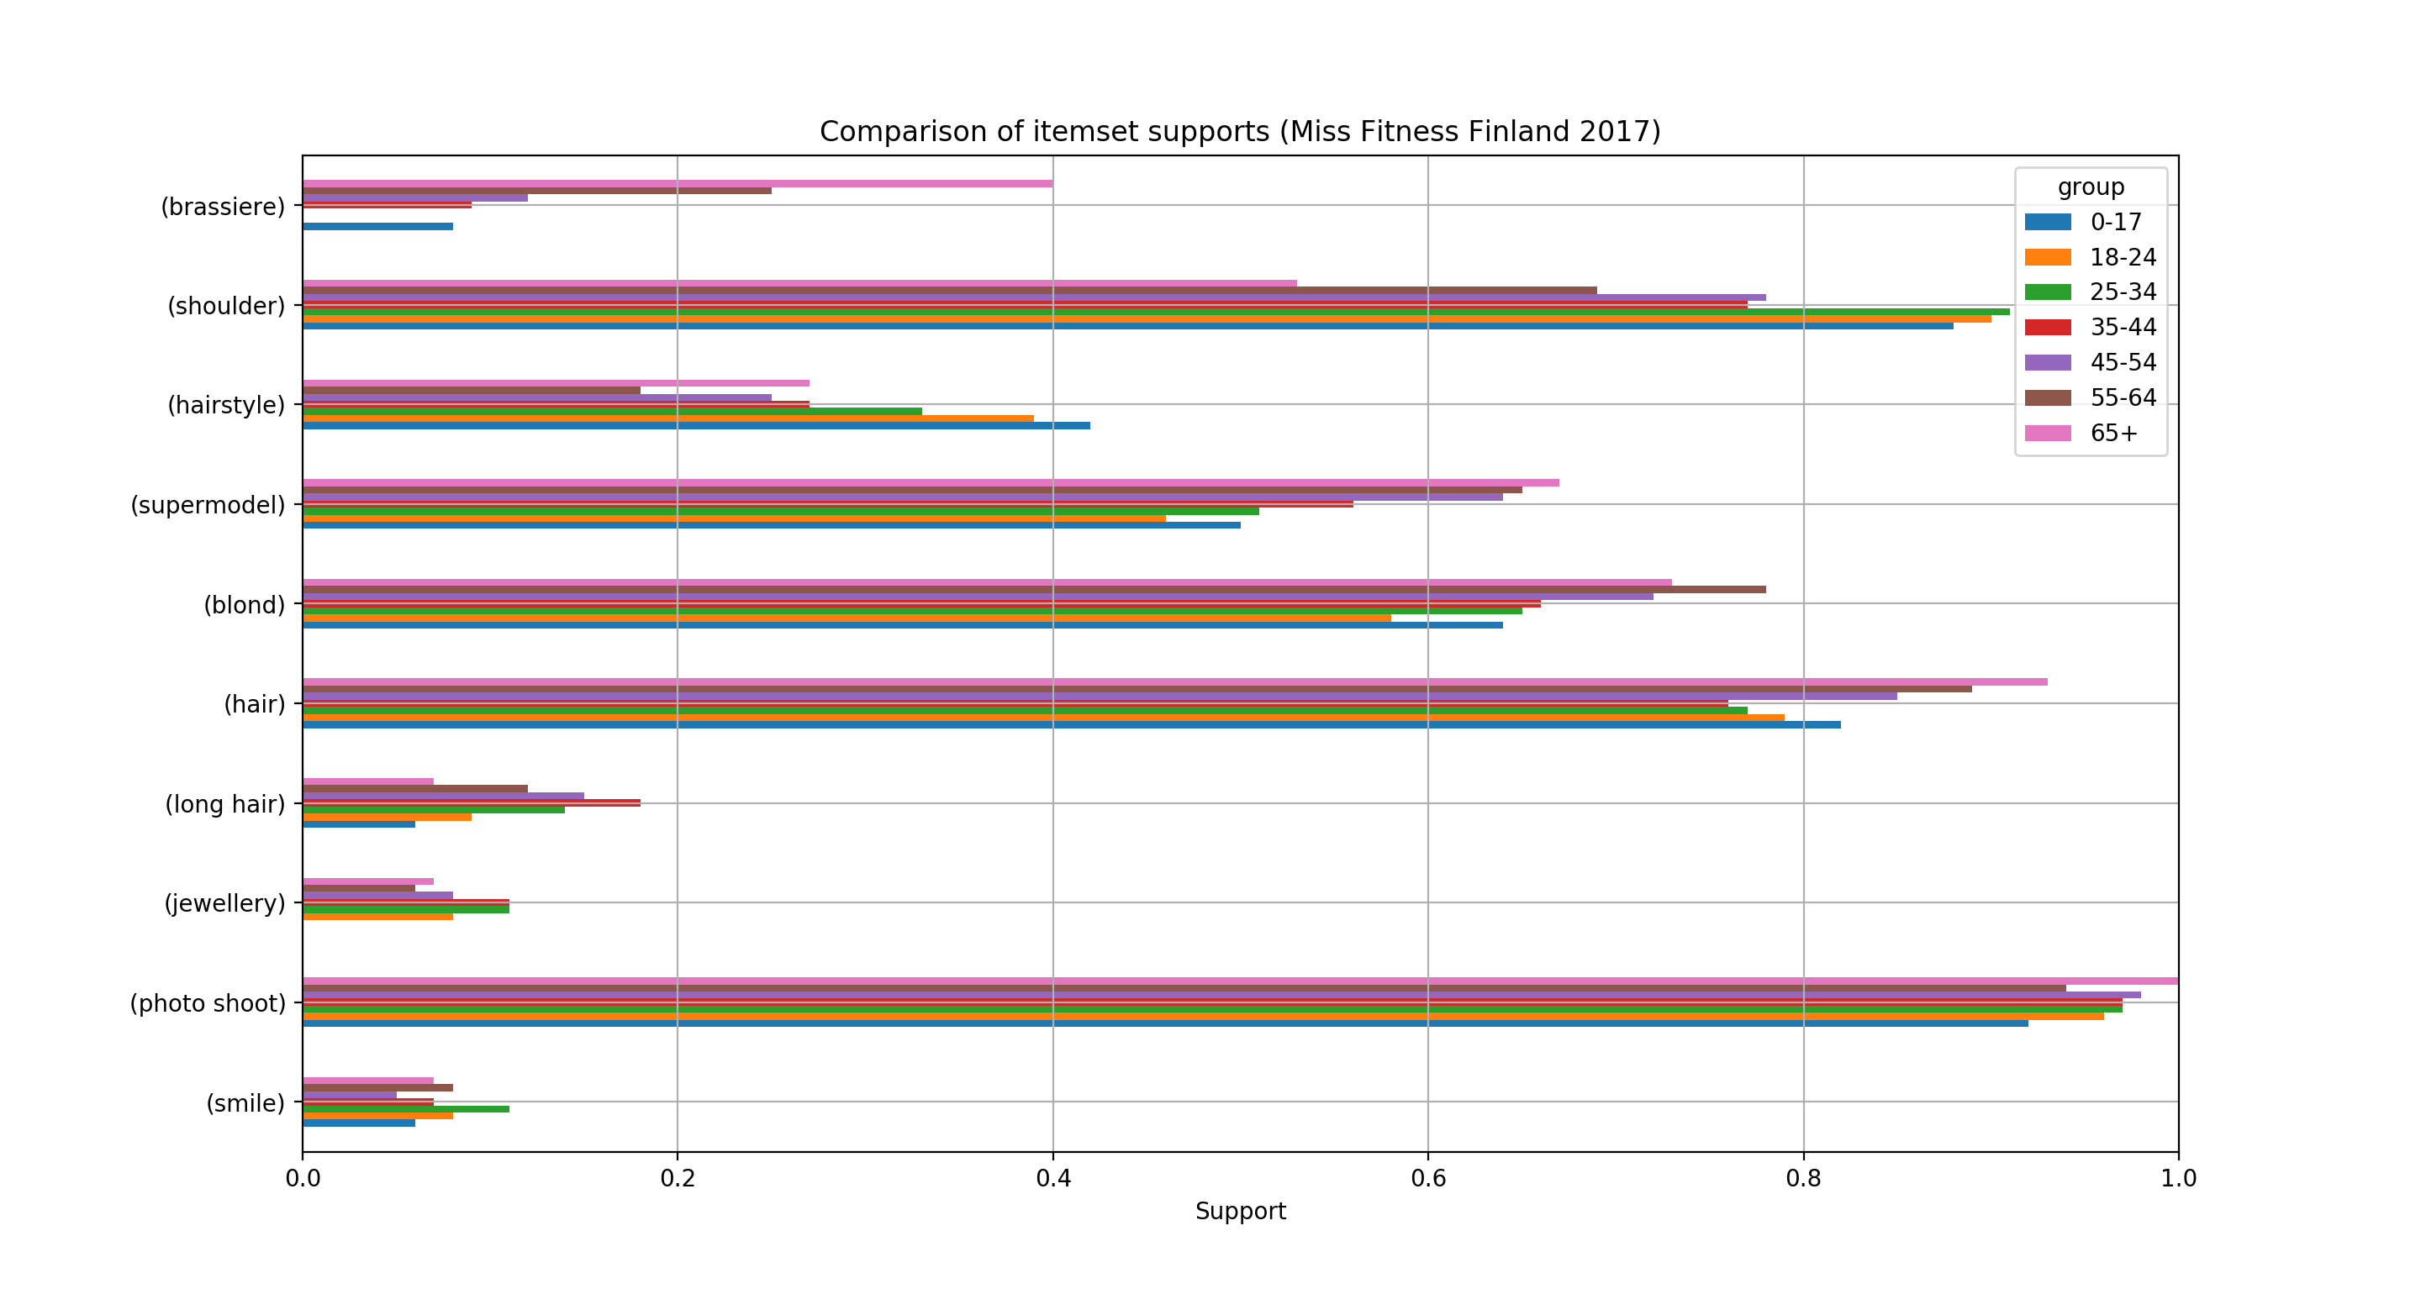
https://choicely.com/contest/7a7b90f8-84c7-11e7-a452-a9f8b94782fe/

Slide 14
Comparing supports of itemsets
Itemset (X) | S(X | gender=female) | S(X | gender=male)
(model, jewellery) | 0.00 | 0.18
(shoulder, hair) | 0.72 | 0.54
(hair, blond) | 0.54 | 0.47
(jewellery) | 0.00 | 0.18
(long hair, beauty) | 0.12 | 0.16
(long hair, blond) | 0.12 | 0.16
(hairstyle, hair) | 0.32 | 0.26
(smile) | 0.08 | 0.07
(brassiere) | 0.07 | 0.00
https://choicely.com/contest/7a7b90f8-84c7-11e7-a452-a9f8b94782fe/

Slide 15
Comparing ranks of itemsets
Itemset (X) | rank(X | age=0-17) | rank(X | age=18-24) | rank(X | age=25-34) | rank(X | age=35-44) | rank(X | age=45-54) | rank(X | age=55-64) | rank(X | age=65+)
{'shoulder'} | 32 | 32 | 32 | 32 | 64 | 112 | 256
{'photo shoot'} | 16 | 16 | 16 | 16 | 16 | 16 | 1
{'shoulder', 'hair'} | 96 | 96 | 96 | 192 | 208 | 288 | 288
{'fashion model', 'blond'} | 112 | 128 | 112 | 96 | 96 | 64 | 64
{'blond', 'beauty', 'model', 'shoulder', 'fashion model'} | 160 | 160 | 160 | 320 | 320 | 320 | 576
{'shoulder', 'blond', 'photo shoot'} | 256 | 240 | 176 | 336 | 336 | 352 | 576
{'smile'} | 896 | 896 | 896 | 1216 | 1216 | 1152 | 896
{'model', 'jewellery'} | 1792 | 896 | 896 | 896 | 1152 | 1792 | 896
https://choicely.com/contest/7a7b90f8-84c7-11e7-a452-a9f8b94782fe/

Slide 16
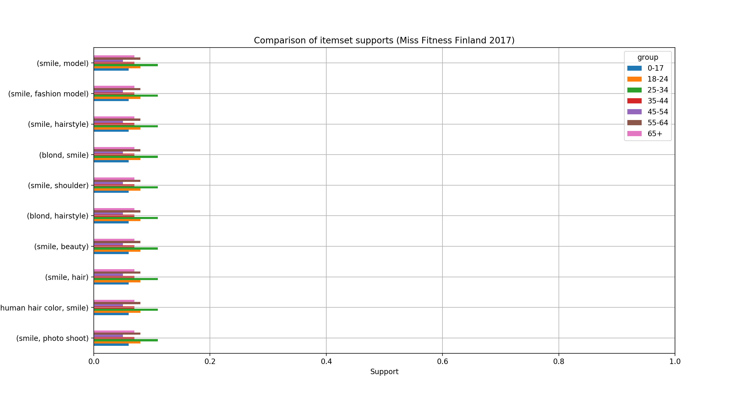
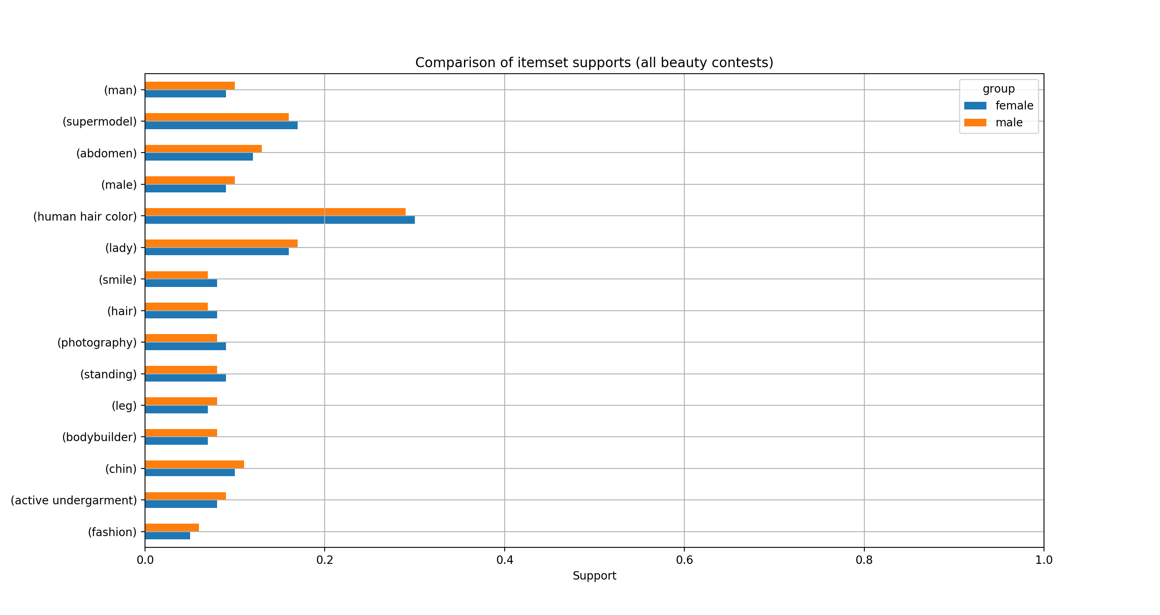
https://choicely.com/contests/finished/beauty

Slide 17
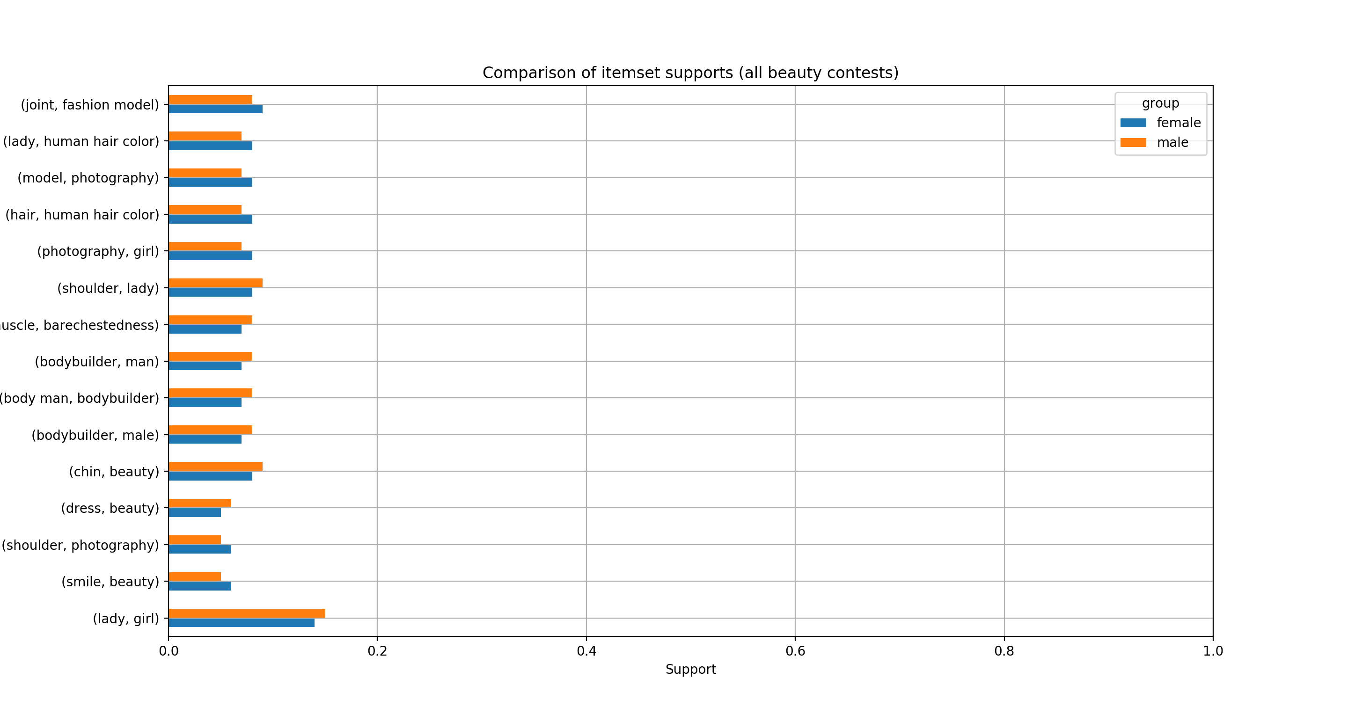
https://choicely.com/contests/finished/beauty

Slide 18
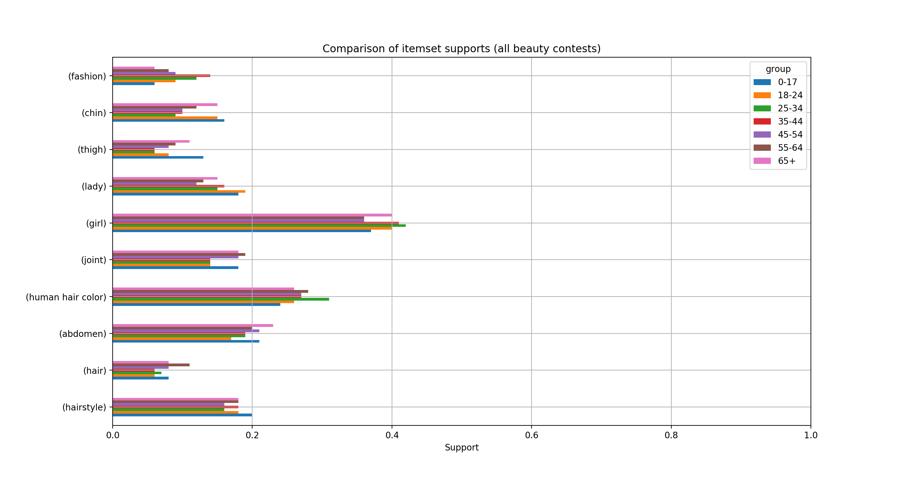
https://choicely.com/contests/finished/beauty

Slide 19
Choose wisely, use Questions?
Péter Ivanics
Peter.ivanics@helsinki.fi
httpS://choicely.com

